Slide 1
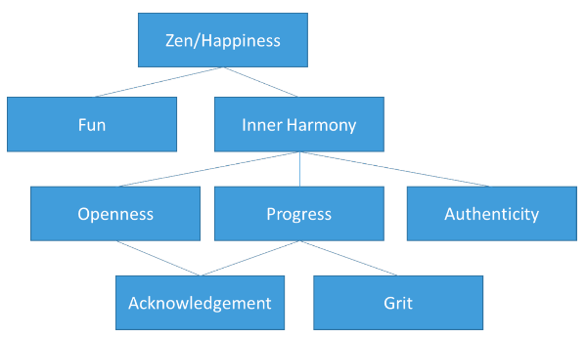
David Ackerman

Slide 2
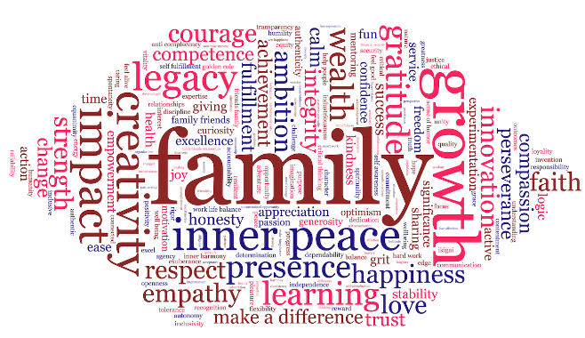

Slide 3
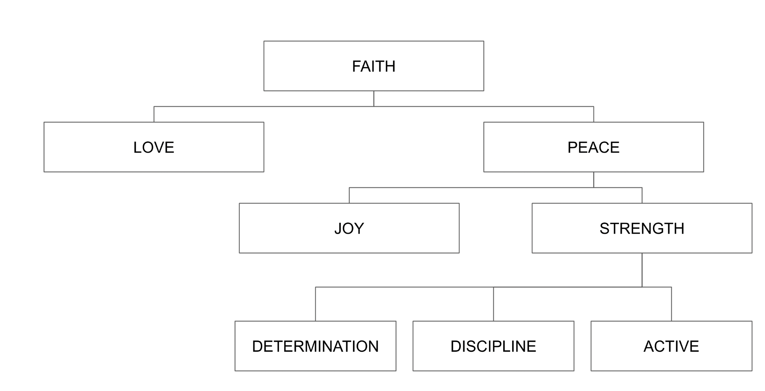
Saddmun Ahsan

Slide 5
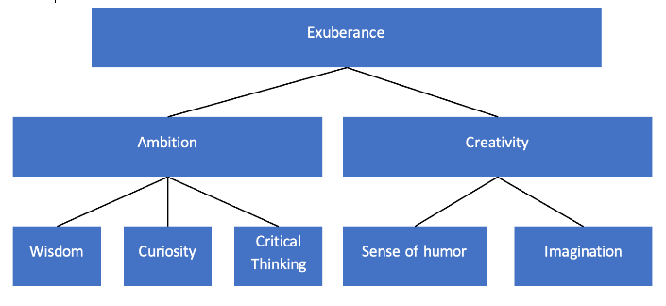
Mohammad Awais

Slide 7
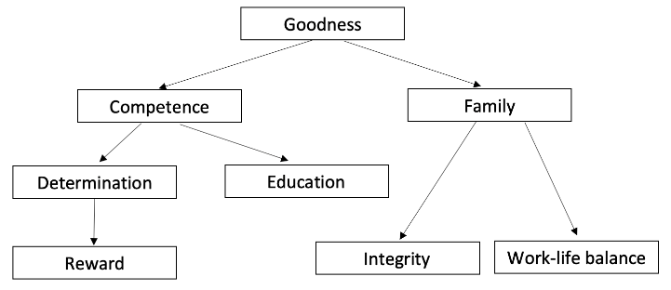
John Banas

Slide 9
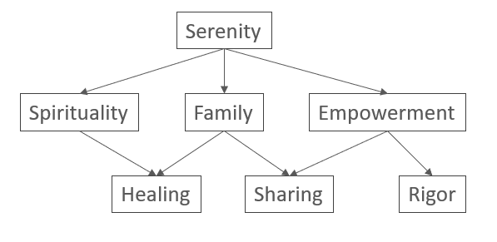
Aidyn Battalov

Slide 11
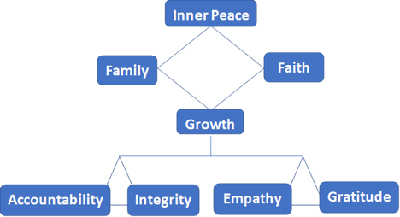
LaNisha Bodley

Slide 13
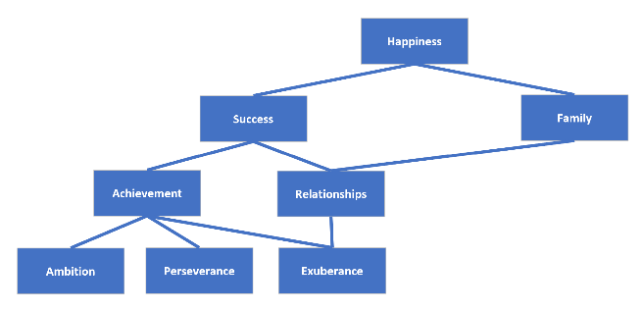
Brett Carr

Slide 15
Ibi Chambers

Slide 17
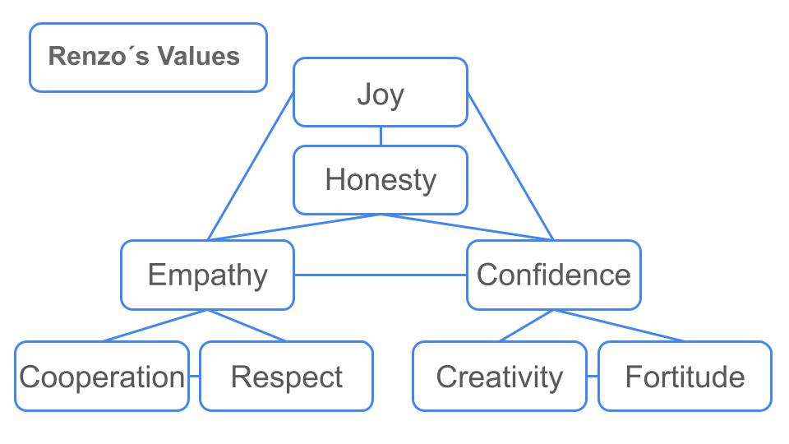
Renzo De La Cruz

Slide 19
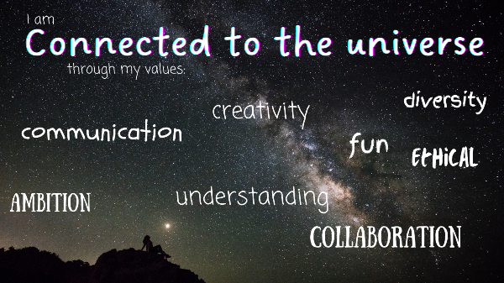
Olivia Erickson

Slide 21
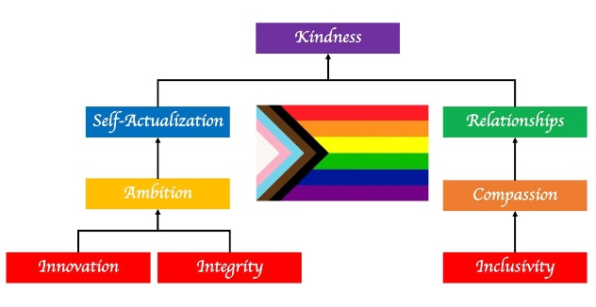
Moises Figueroa Contreras

Slide 23
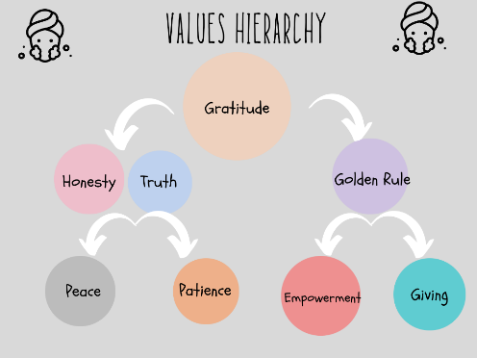
Vineeth Gogineni

Slide 25
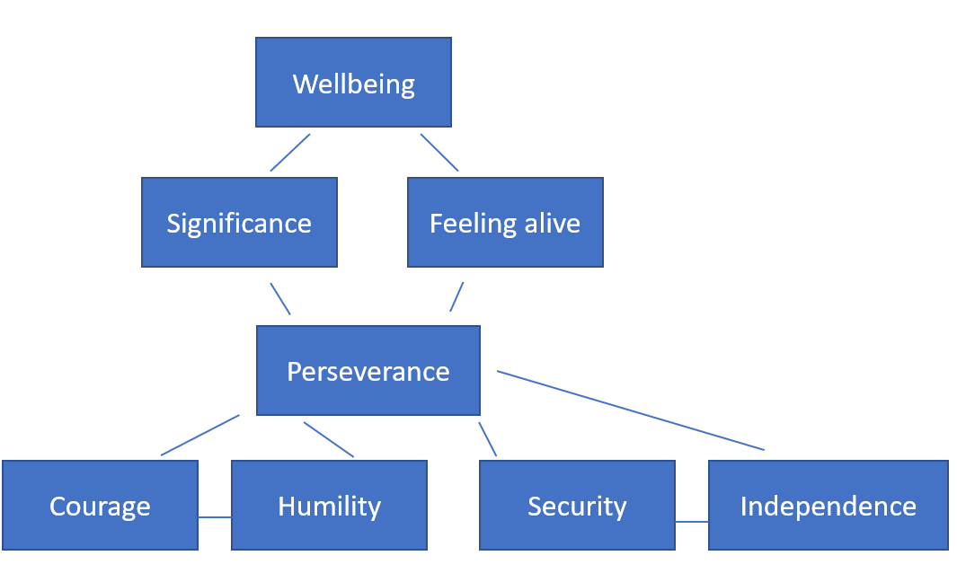
Michael Goldenberg

Slide 27
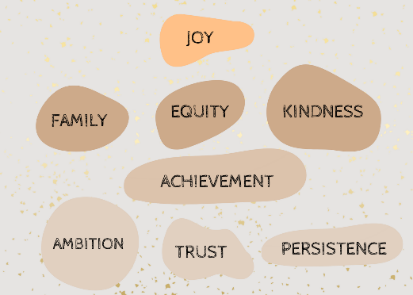
Nicole Green

Slide 29
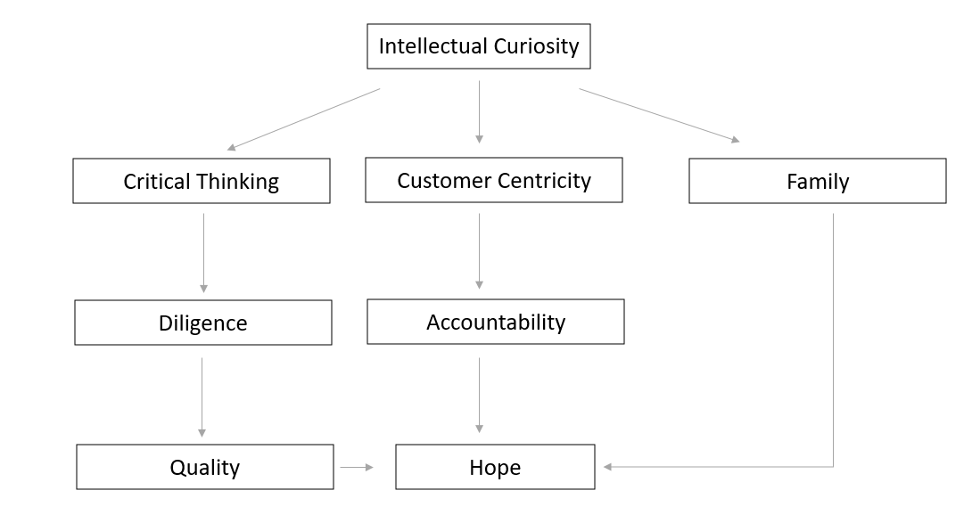
Manav Gupta

Slide 31
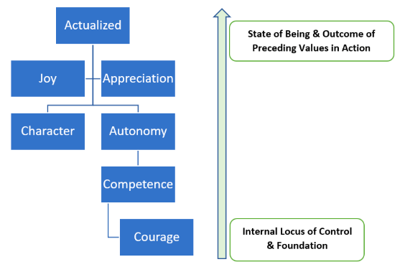
Erickarlos Gutierrez

Slide 33

Emily Hecht

Slide 35
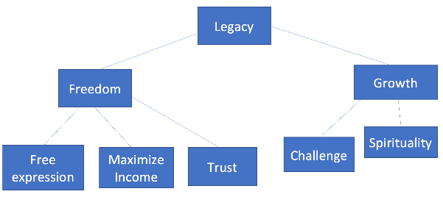
Arjun Iyer

Slide 37
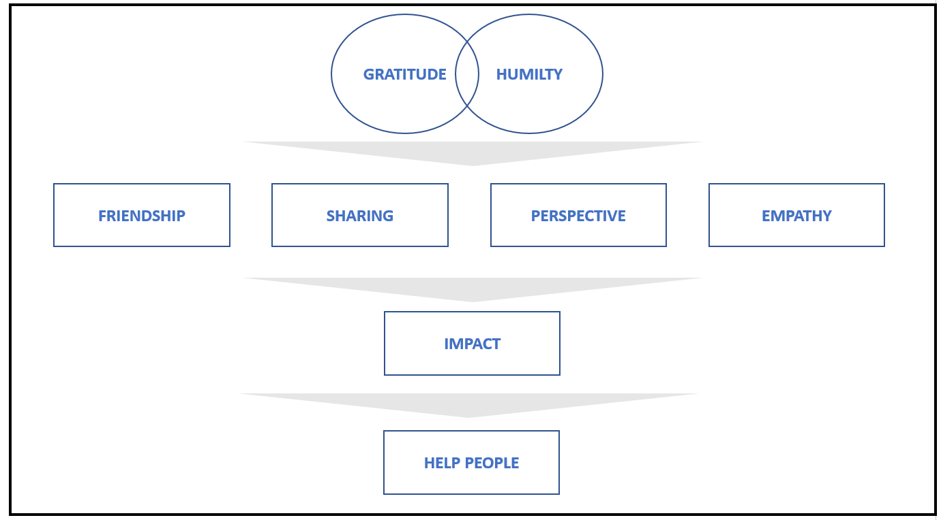
Deepak Kamble

Slide 39
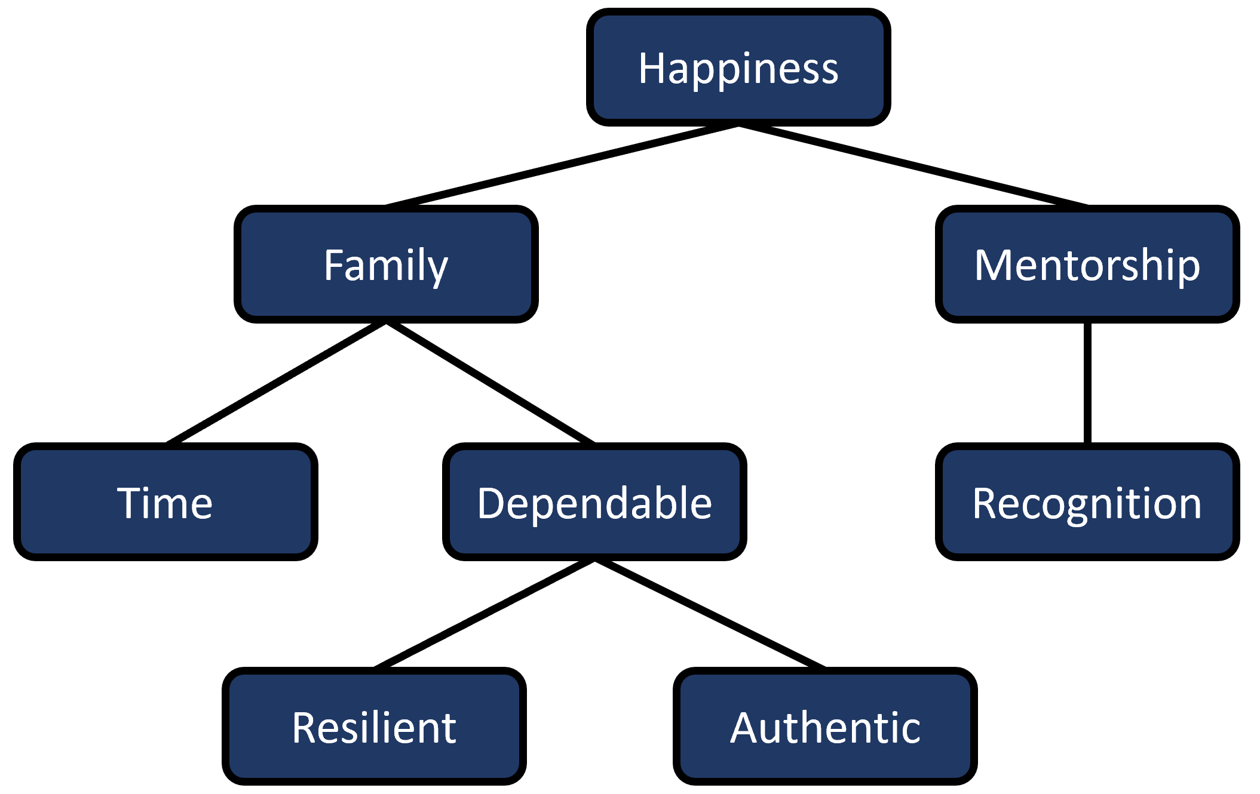
Jeffery Larson

Slide 41
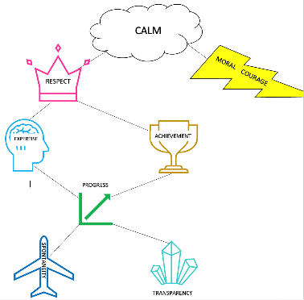
Jennifer Manghisi

Slide 43
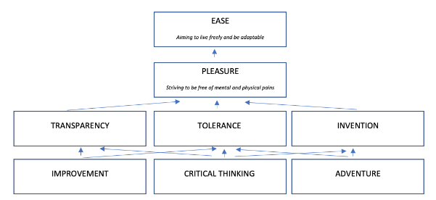
Hadrien Markabi

Slide 45
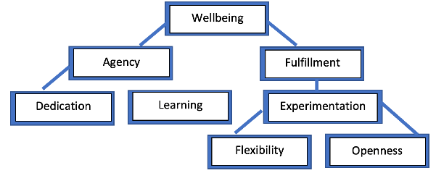
David Mishael

Slide 47
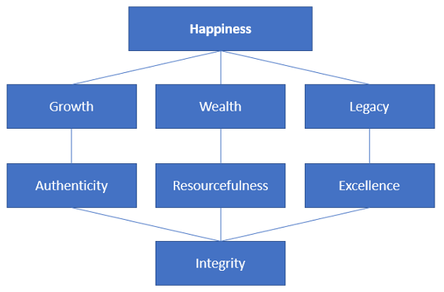
Andrea Pavlovic

Slide 49
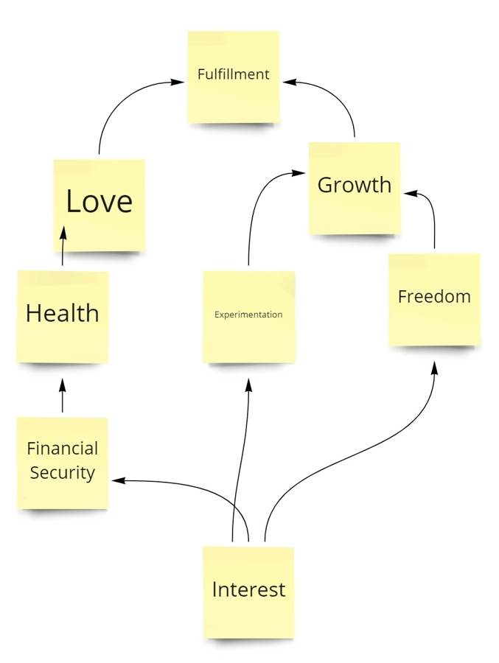
Haas Rahman

Slide 51
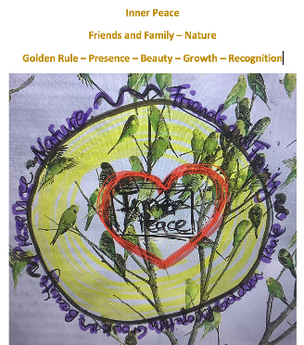
Vanessa Robatzek

Slide 53
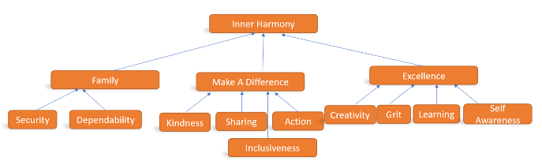
Smita Sebastian

Slide 55
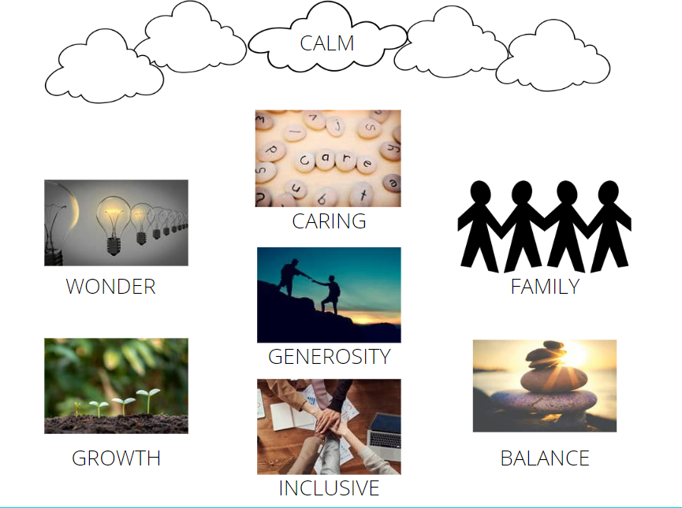
Noel Simon

Slide 57
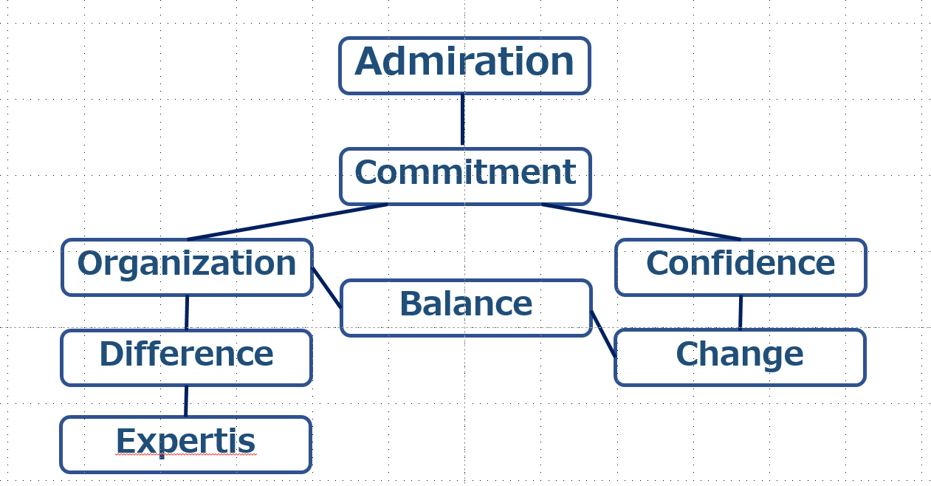
Haruhiko Sugino

Slide 59
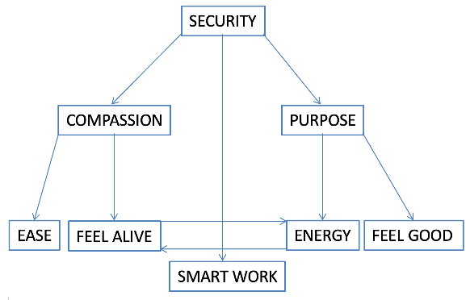
Jonathan Wu

Slide 61
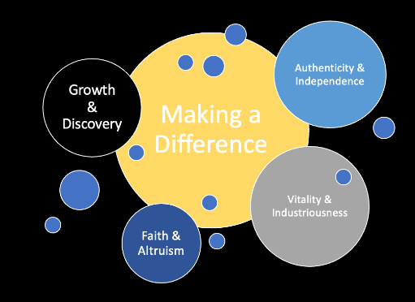
Tommy Ibrahim

Slide 63
Michael Martini
Fulfillment
Achievement
Success
Character
Family
Growth
Giving
Passion

Slide 65
Joseph Alukal
Ikigai
Humanity
Family
Agency

Slide 67
Michael Fitzsimmons
Calm
Freedom
Presence
Family + Friends
Wealth
Impact
Courage
Creativity

Slide 69
Micah Karson
Unconstrained Opportunity
Outcomes
Presence
Passion
Health
Commitment
Laughter
Active

Slide 71
Arda Sener
Tranquility
Growth
Intellectualism
Eustasy
Enthusiasm
Humorous
Initiative
Maximize Income

Slide 73
Adrian Jacques Ambrose
Greatness
Happiness
Love
Self-actualization
Gratitude
Anti-complacency
Achievement
Industriousness

Slide 75
Joshua Kuckley
Impact
Family
Motivation
Persistence
Financial Security
Help people
Social Justice
Make a difference
Change

Slide 77
David Nimmo
Fulfillment
Integrity
Respect
Impact
Appreciation
Success
Reliability
Opportunity

Slide 79
Jitesh Shahani
Purpose
Positivity
Giving
Family, Friends & Relationships
Wealth
Change
Balance
Hardwork

Slide 81
Michael Mazur
Equanimity
Focus
Innovation
Grit
Discipline
Hard work
Ambition
Motivation

Slide 83
Monika Raj
Self fulfillment
Accomplishment
Secure
Ambition
Family & friends
Grit
Honesty
Loyalty

Slide 85
Carolina Cromeyer-Dieke
Feel good
Success
Health
Family
Wealth
Strength
Love & Affection
Legacy

Slide 87
Grace Jansen
Respect
Strength
Passion
Autonomy
Ambition
Engaged
Stimulation
Bravery

Slide 89
Lakeisha Jones
Pleasure
Legacy
Creativity
Flexibility
Family
Time
Wealth
Health

Slide 91
April Moorhouse
Stability
Strength
Honesty
Development
Work-life
Balance
Reflection
Listening
Partnership

Slide 93
Sumer Sanghi
Inner peace
Moral Courage
Optimism
Commitment
Equity
Dedication
Imagination
Motivation

Slide 95
Sonia Espejo
Inner peace
Love
Freedom
Connected
Authenticity
Growth
Dependability
Curiosity

Slide 97
Cathy Jiang
Unconditional Love
Giving
Trust
Reward
Excel
Consistency
Monitoring
Faith

Slide 99
Anshuman Moghe
Make things better
Justice
Logic
Self-awareness
Responsibility
Presence
Learning
Mentoring

Slide 101
Sen Han
Grace
Family
Significance
Achievements
Innovation
Opportunity
Optimism
Excel

Slide 103
Rohan Parikh
Inner Peace
Family
Appreciation
Legacy
Generosity
Impact
Courage

Slide 105
Shannon Armstrong
Stability
Learning
Family + Family
Sharing
Playfulness
Honesty
Action
Kindness

Slide 107
Candace Ge
Harmony
Service, impact, empathy
Family and friends
Adventure, perseverance, creativity

Slide 109
Eugene Lee
Fulfillment
Wellbeing
Competence
Learning
Innovation
Edge
Resilience
Balance work life

